Slide 1
Network Programming Lab

Slide 2
Goals for this Lab
Retrieve a remote machine’s IP address.
Convert the IP address to different format.
Finding the service name, given the port and protocol of the remote host (server)

Slide 3
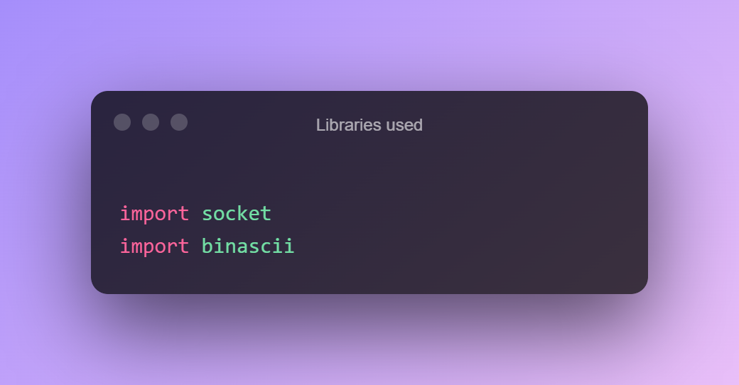
Libraries Used
Socket
Binascii (for conversion)

Slide 4
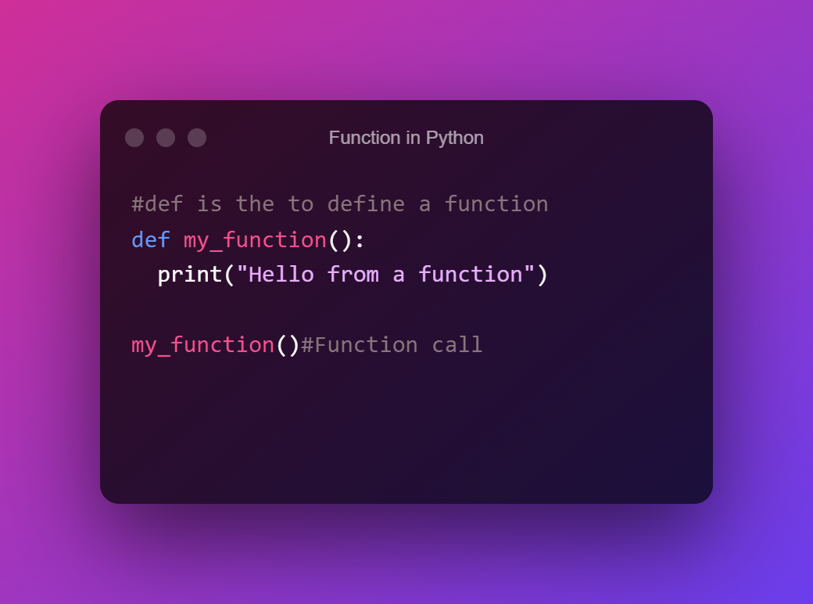
Function in Python

Slide 5
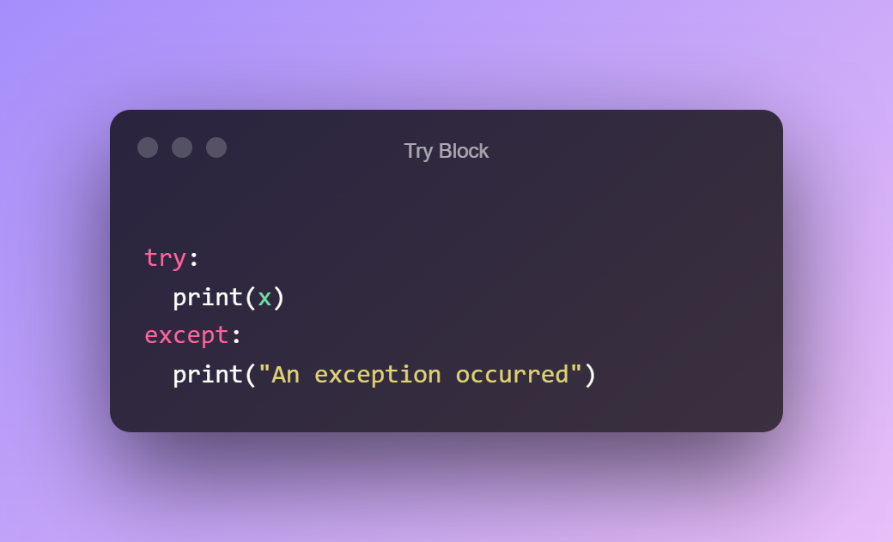
Try Except and Finally
The try block lets you test a block of code for errors.

Slide 6
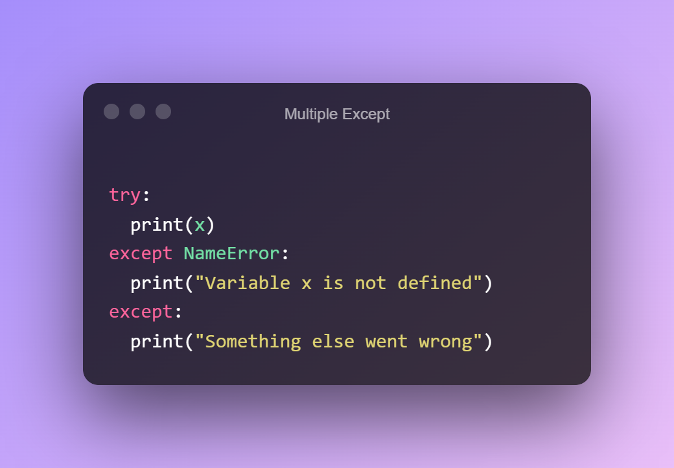
Contd.
The except block lets you handle the error.

Slide 7

Contd.
The finally block lets you execute code, regardless of the result of the try- and except blocks.

Slide 8
Retrieve a remote machine’s IP address.
We will use Socket library.
We will take the address of a remote website and try to retrieve it’s IP.
If we fail to access it the program should display an Error.
Error should be taken care by using try and except.

Slide 9
Convert the IP address to different format
We have to create a program that will convert IP addresses to a different format.
127.0.0.1 to Hexadecimal.
We have to use socket and binascii library to convert the address to Hexadecimal code.
We need this because sometime the usual notation doesn’t work since it is represented as 127.0.0.1, that’s why we need to convert it.
We have to convert it to hex first and then convert hex back to the normal IPv4 address.

Slide 10
Finding the service name
If you would like to discover network services, it may be helpful to determine what network services run on which ports using either the TCP or UDP protocol.
If you know the port number of a network service, you can find the service name.

Slide 11
Port Numbers
Number | Assignment
20 | File Transfer Protocol (FTP) Data Transfer
21 | File Transfer Protocol (FTP) Command Control
22 | Secure Shell (SSH) Secure Login
23 | Telnet remote login service, unencrypted text messages
25 | Simple Mail Transfer Protocol (SMTP) email delivery
53 | Domain Name System (DNS) service
80 | Hypertext Transfer Protocol (HTTP) used in the World Wide Web
110 | Post Office Protocol (POP3)

Slide 12
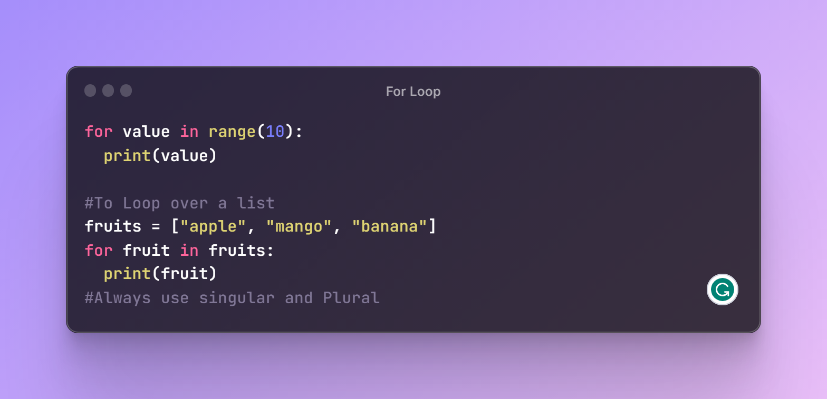
For Loop

Slide 13
Problem to be Solved
Add a loop in the range of 1 to 1000 (PORT).
If any of the values are used as a port number it should print you the service name.
range(1000) is the function used in python.
Use socket help to find the essential function.

Slide 14
Todays Assignment
Create three functions:
Retrieve a remote machine’s IP address.
Convert the IP address to different format.
Finding the service name, given the port and protocol of the remote host (server) from 1 to 1000.

